Slide 1
Advanced Java Programming B.Sc.CSIT Seventh Semester
By Narayan Subedi

Slide 2
Distributed Application using RMI

Slide 3
Distributed Application
A distributed application is software that is executed or run on multiple computers within a network.
These applications interact in order to achieve a specific goal or task.
Traditional applications relied on a single system to run them. Even in the client-server model, the application software had to run on either the client, or the server that the client was accessing. However, distributed applications run on both simultaneously.
The very nature of an application may require the use of a communication network that connects several computers: for example, data produced in one physical location and required in another location.

Slide 4
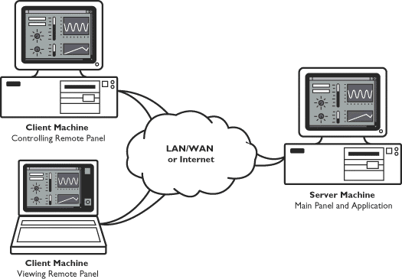
Distributed Application
There are many cases in which the use of a single computer would be possible in principle, but the use of a distributed system is beneficial for practical reasons. For example, it may be more cost-efficient to obtain the desired level of performance by using a cluster of several low-end computers, in comparison with a single high-end computer.

Slide 5
Remote Method Invocation (RMI)
Remote Method Invocation (RMI) allows a Java object that executes on one machine to invoke a method of a Java object that executes on another machine.
This is an important feature, because it allows you to build distributed applications.

Slide 6
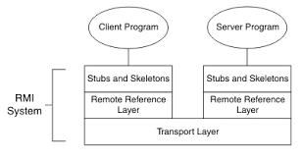
RMI Layers
Stub and Skeleton Layer
The stub and skeleton layer is responsible for marshaling and unmarshaling the data and transmitting and receiving them to/from the Remote Reference Layer
Remote Reference Layer
The Remote reference layer is responsible for carrying out the invocation.
Transport Layer
The Transport layer is responsible for setting up connections, managing requests, monitoring them and listening for incoming calls

Slide 7
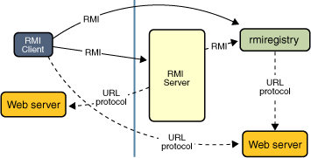
RMI Mechanism
Locate remote objects. Applications can use various mechanisms to obtain references to remote objects. For example, an application can register its remote objects with RMI's simple naming facility, the RMI registry.
Communicate with remote objects. Details of communication between remote objects are handled by RMI.
Load class definitions for objects that are passed around. Because RMI enables objects to be passed back and forth, it provides mechanisms for loading an object's class definitions as well as for transmitting an object's data.

Slide 8
RMI Registry
Essentially the RMI registry is a place for the server to register services it offers and a place for clients to query for those services.
RMI Registry acts a broker between RMI servers and the clients.
A Simple Client/Server Application Using RMI
This section provides step-by-step directions for building a simple client/server application by using RMI. The server receives a request from a client, processes it, and returns a result.

Slide 9
Questions ???

